Slide 1
01
DATASET PROFILE
Rat perceptual decision-making task
Predicting Rat Decision Latency
1,873
9
trial observations
rats
A Multiple Linear Regression Approach
14
10
STAT 415 • Group Project
variables
quantitative
Yating, Rain and Kevin
RESEARCH QUESTION
Can we predict a rat's decision latency from its movement velocity and time-to-peak velocity during a trial?

Slide 2
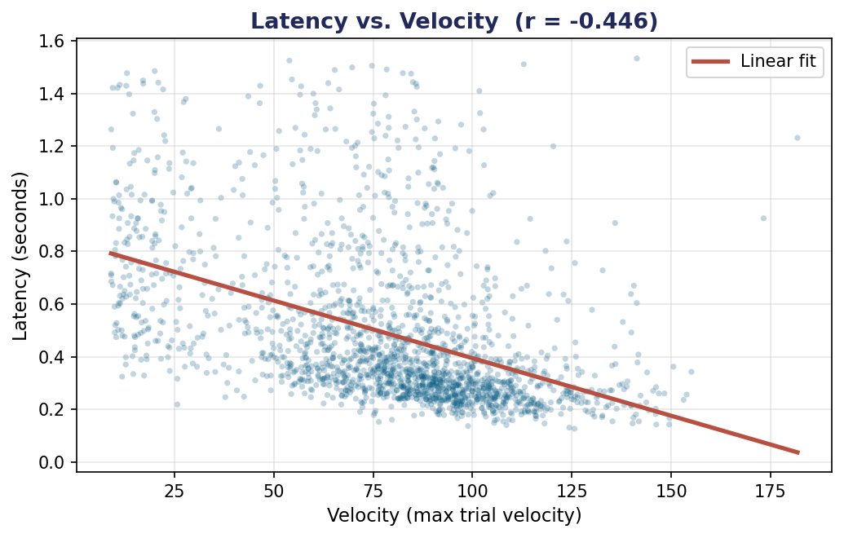
modelone: Building & Diagnosing the Regression
latency ~ velocity + time2peak
R CODE
# Load data
rats <- read.csv("STAT615_Project1_CLEAN.csv")
# Fit the model
modelone <- lm(latency ~ velocity + time2peak,
data = rats)
# Residuals & fitted values
resid_vals <- residuals(modelone)
fitted_vals <- fitted(modelone)
# 95% CI for predictors
confint(modelone, level = 0.95)
# Multicollinearity check
library(car)
vif(modelone)
# Significance & Adjusted R^2
summary(modelone)
MULTICOLLINEARITY CHECK
VIF (velocity) = 1.02
VIF (time2peak) = 1.02
Both VIF values are well below 5 — predictors are essentially independent, no multicollinearity concern.

Slide 3
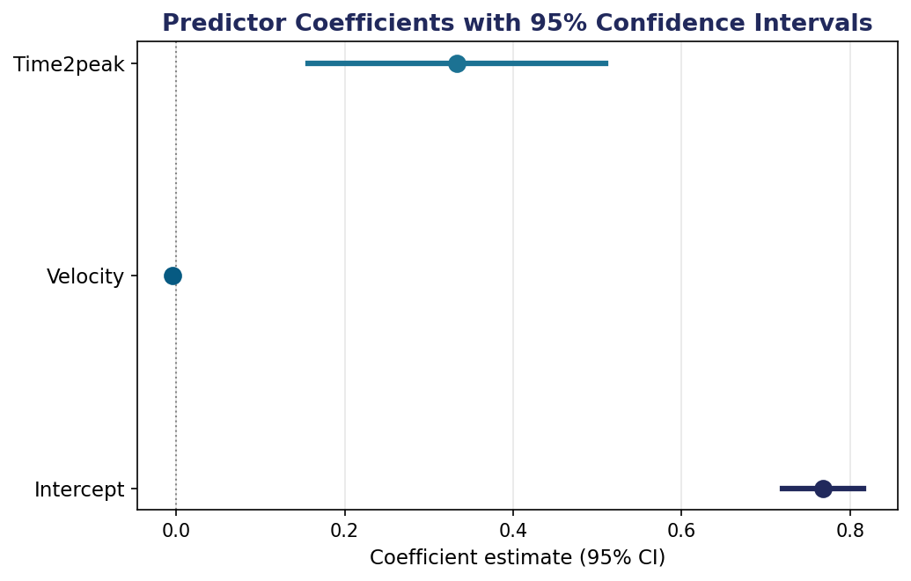
Results: A Significant but Modest Predictor of Latency
0.204
240.5
< 0.001
Adjusted R²
F-statistic (2, 1870)
p-values for predictors
20.4% of variance explained
p < 2.2 × 10⁻¹⁶
Both highly significant
INTERPRETATION
▸
Velocity → −0.0043
Faster rats have shorter latencies. Each unit increase in max velocity reduces latency by ~4 ms.
▸
Time2peak → +0.333
Longer time to reach peak velocity is associated with longer latency.
▸
95% CIs exclude 0
Both effects are statistically reliable, not due to sampling chance.
TAKEAWAY
modelone is highly significant overall, but Adj R² = 0.20 means kinematics alone leave ~80% of latency variance unexplained — cognitive factors matter too.

